Slide 1

What is The Rails Way
-The Basics and Beyond-
Composed By: Hayato Ishida
For Japanese version, click here
Updated On: 14 November 2025

Slide 2

About Me
Accounts
GitHub: @hayat01sh1da
X: @hayat01sh1da
LinkedIn: @hayat01sh1da
Speaker Deck: @hayat01sh1da
Docswell: @hayat01sh1da
Occupation: Software Engineer
Things I Am Into
Linguistics
Singing at Karaoke
Listening to Music
Watching Movies
Cat Feeding

Slide 3
Licences / Certifications
English
TOEIC® Listening & Reading 915: Certified on December 2019
Engineering
Information Security Management: Certified on November 2017
Applied Information Technology Engineer: Certified on June 2017
Fundamental Information Technology Engineer: Certified on November 2016
IT Passport: Certified on April 2016
Others
Abacus 2nd Class: Certified on June 2002
Mental Arithmetic 3rd Class: Certified on February 2001

Slide 4
Skill Stack
Languages
Japanese: Native Proficiency
English: Full professional Proficiency
Development
Backend: Ruby(Ruby on Rails), Python
Frontend: TypeScript + React.js, TypeScript +Vue.js
Database: MySQL, PostgreSQL, MongoDB
Architecture: Monolith, Modular Monolith
Hosting: AWS ESK
Versioning: Git, GitHub
CI/CD: GitHub Actions, ArgoCD
Monitoring: Datadog, Sentry

Slide 5
Work Histories
Period | Genre | Position | Jobs
Aug 2021 - Present | Saas(Educational Service) | Software Engineer | Backend Development Frontend Development CI/CD Maintenance Weekly Release Manager Troubleshooting Documentation Technical Debt Resolution Tech Blog Entries LT Speaker
Feb 2020 - Dec 2020 | SaaS(Chatbot Platform) | Backend Engineer | Backend Development Documentation Technical Debt Resolution Inspection of Alternative API

Slide 6
Work Histories
Period | Genre | Position | Jobs
Jun 2018 - Jan 2020 | Contract-basis Developer | Software Engineer | Backend Development Frontend Development Troubleshooting Quality Assurance Tech Blog Entries
Apr 2016 - Jan 2018 | System Engineering Service | System Engineer | Corporate Account Admin Windows Server Maintenance Security Admin Assistant Internationalisation / Localisation

Slide 7
International-Exchange Activities
Activities in University
English Linguistics Seminar(Focusing on Mass Media English)
International-Exchange Clubs(The 2nd Year)
International-Exchange Programmes conducted by Japan Cabinet Office(2013 - 2016)
Japanese Linguistics Course(The Final Year)
Overseas Life Experience
Working Holiday in Australia(April 2014 - March 2015)
Language School for 1 month in Sydney
Work for 6 Months in Hamilton Island Resort
Volunteering for 1 Month as Assistant Teacher of Japanese Language at St Ives High School in NSW
Other Activities
Keep Everyday Journal in English (April 2014 - Present)
Sunrise Toastmasters Club(February 2017 - March 2018)
Vital Japan(January 2018 - July 2019, October 2022 - February 2023)
Self Learning and Training of English Language
Participation Ruby-Related Tech Conferences

Slide 8
Agenda
What brought me this interest?
Philosophy of "The Rails Way" -MVC vs. Layered-
Key Responsibilities -MVC vs. Layered-
Key Components of The Extended Rails Way(Layered)
Pros & Cons
Pragmatic Adoption Strategy
Survey and Answers
Summary
References

Slide 9
1. What brought me this interest?

Slide 10
1. What brought me this interest?
My Pains at Optimisation of Messy Ecosystem of Rails App
Nested domain namespaces: Systems and Accounts
* Illustrated on the next slide
Inconsistencies in implementation of logics and place
Too redundant layers
→ CQRS, Forms, Validators, Decorators, Serializers etc.
Unmanaged routing segregation between backend and frontend
Not modular but "omnibus" monolith
→ No idea "What The Rails Way Is"!!

Slide 11
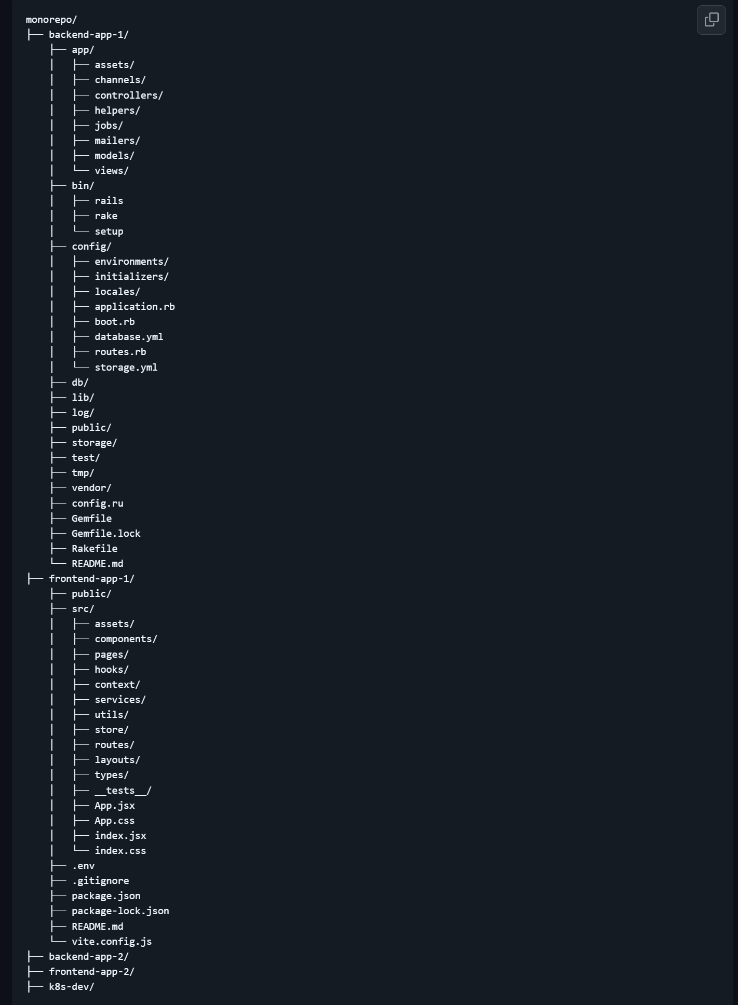
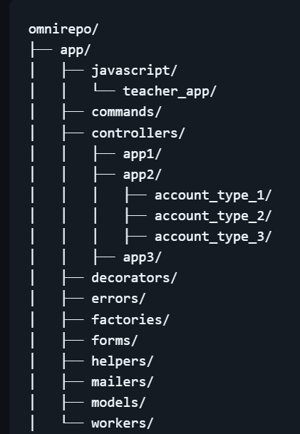
1. What brought me this interest?
Modular Monolith vs. Omnibus Monolith
vs.

Slide 12

1. What brought me this interest?
A Rubyist published the post on Kaigi on Rails 2025, which said…
"What on earth is The Rails Way?"

Slide 13

1. What brought me this interest?

Slide 14
1. What brought me this interest?
The Reasons to Agree
No official definition of "The Rails Way"
→ So many Rubyists, so many "The Rails Ways"
MVC ecosystem and/or CoC philosophy of the framework?
→ Too ambiguous to be unanimous
Different from Omakase?
→ Even DHH does not describe it as "The Rails Way"
→ No more consensus on a Rails app architecture with "The Rails Way".

Slide 15
1. What brought me this interest?
❌Now is not the time to cry
✅Now's the time to find out why "The Rails Way"
Live Forever - Oasis

Slide 16
2. Philosophy of "The Rails Way" -MVC vs. Layered-

Slide 17
2. Philosophy of "The Rails Way" -MVC vs. Layered-
Traditional MVC Architecture
Convention over Configuration
Draws inference on as much functionality as possible
Based on object names and project structure
Focus less on setups and more on product development
Grammatical Inflections on the number(singular/plural) and the case(e.g. I-my-me)
e.g. User model corresponds to users table of the database
3 layers: MVC
Models (ActiveRecord)
Views (ERB HTML templates)
Controllers (Dataflow control)

Slide 18
2. Philosophy of "The Rails Way" -MVC vs. Layered-
Extended/Layered Architecture
Structured abstractions: Role Segregations
Encapsulated Logic
Focus less on the detailed logics and more on external behaviours
→ Object Oriented
One-on-one single and clear responsibility assignments
Thinner controllers and models
5 (or more) specialized layers:
Presentation
Business/Domain
Application/Service
Data/Persistence
Infrastructure

Slide 19
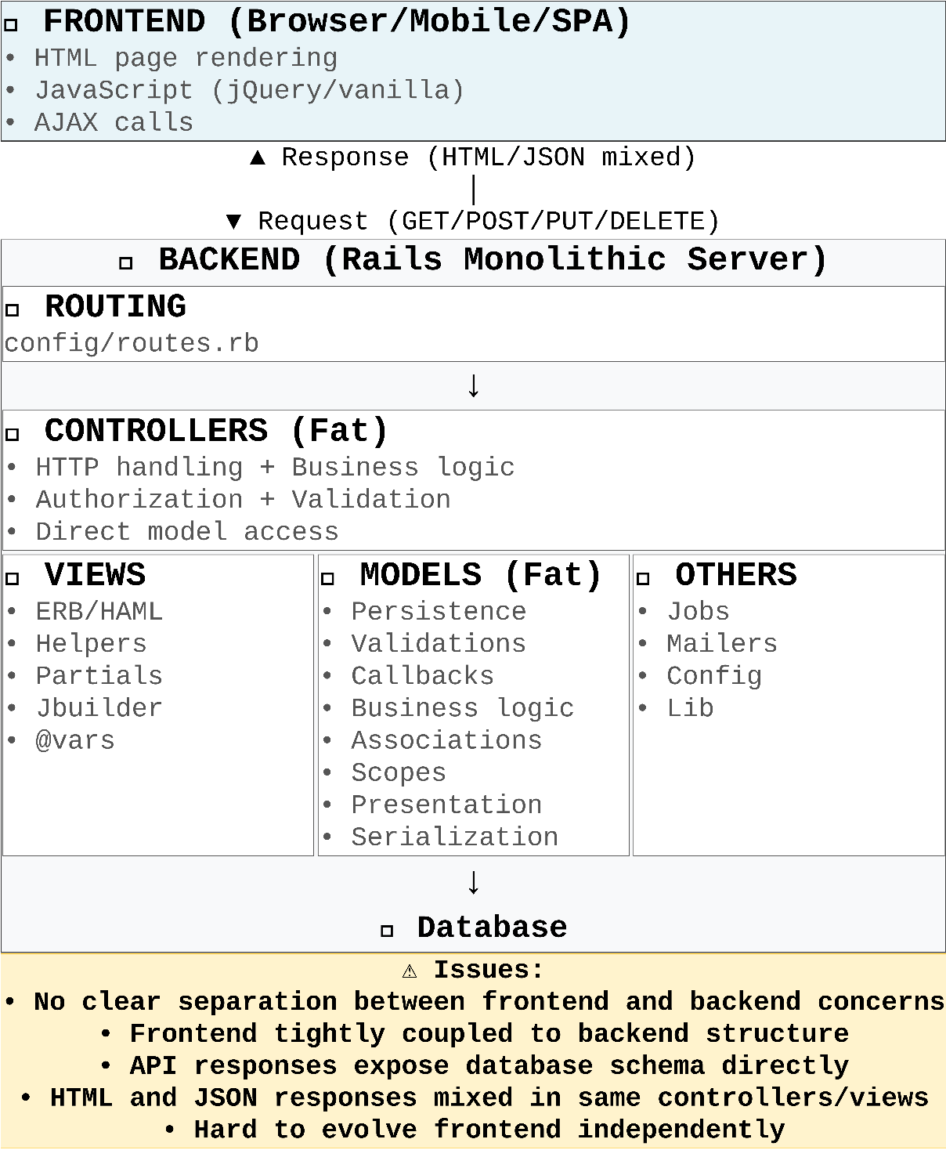
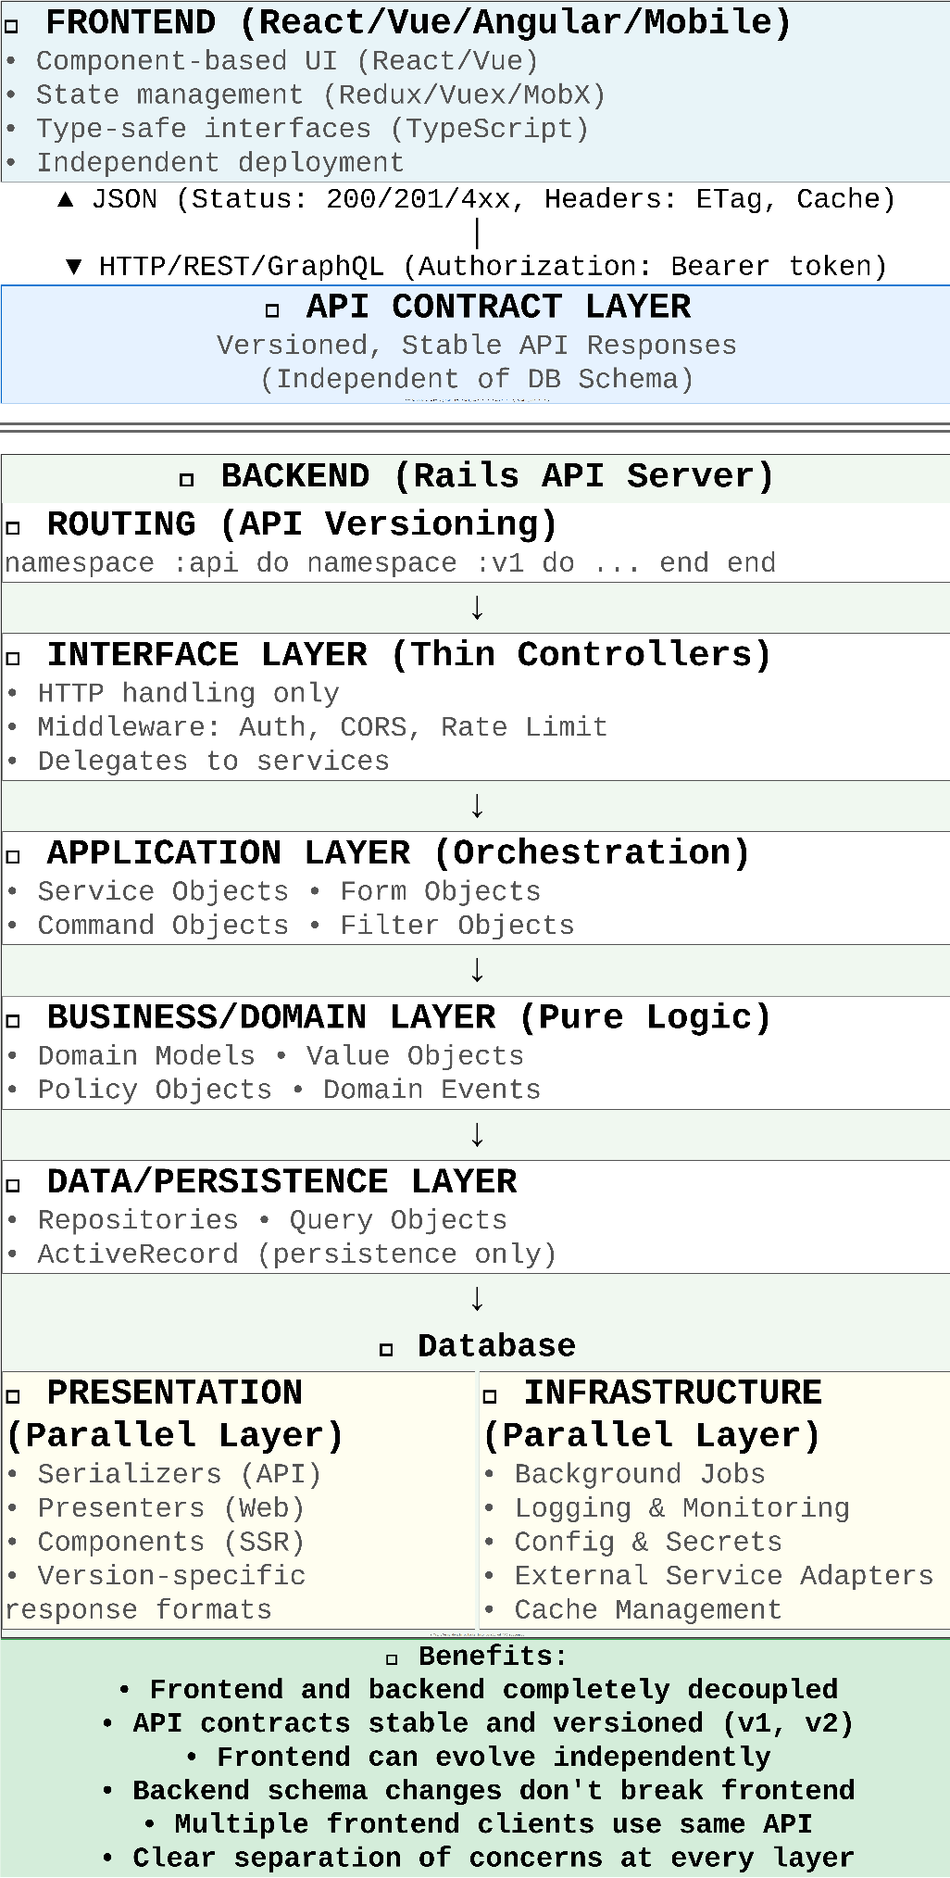
2. Philosophy of "The Rails Way" -MVC vs. Layered-
vs.

Slide 20
3. Key Responsibilities -MVC vs. Layered-

Slide 21
3. Key Responsibilities -MVC vs. Layered-
Responsibility | MVC | Layered
Presentation | app/controllers/*_controller.rb: Instance variables app/helper/*_helper.rb: Custom helper methods ActiveModel::Serializers::JSON#as_json | app/serializers/*_serializer.rb app/view/components/ app/view/presenters/
Form Handling | app/controllers/*_controller.rb: Strong parameters app/model/*.rb: Validations | app/forms/*_form.rb (context-sensitive)
Business Logic | Scattered Everywhere app/controllers/*_controller.rb(including concerns) app/model/*.rb(including concerns) app/views/*.html.erb(⚠️anti-pattern) etc. | app/model/*.rb app/services/*_service.rb
Authorization | app/controllers/*_controller.rb: Callbacks app/model/*.rb: Attributes | app/policies/*_policy.rb (single source of truth)
Data Access | Executed Everywhere app/controllers/*_controller.rb(including concerns) app/model/*.rb(including concerns) app/views/*.html.erb(⚠️anti-pattern) etc. | app/commands/*_command.rb app/repositories/*_repository.rb app/queries/*_query.rb

Slide 22
4. Key Components of The Extended Rails Way(Layered)

Slide 23
4. Key Components of The Extended Rails Way(Layered)
4-1. Presentation Layer
View Components: Explicit interfaces
Presenters: Context-aware formatting
Serializers: API contracts, versioning

Slide 24
4. Key Components of The Extended Rails Way(Layered)
4-2. Application/Service Layer
Service Objects: Single business operation
Form Objects: Multi-model operations, context validations
Filter Objects: User-driven queries

Slide 25
4. Key Components of The Extended Rails Way(Layered)
4-3. Business/Domain Layer
Domain Models: Rich behavior, no persistence details
Policy Objects: Authorization rules
Value Objects: Immutable domain concepts

Slide 26
4. Key Components of The Extended Rails Way(Layered)
4-4. Data/Persistence Layer
Repositories: Data access abstraction
Query Objects: Reusable complex queries
ActiveRecord: Stripped down to persistence only

Slide 27
5. Pros & Cons

Slide 28
5. Pros & Cons
The Traditional MVC Architecture
👍Rapid Development: Accessible built-in commands and generators
👍Convention over Configuration: More productive with the least extensive configurations
👍Rich Ecosystem of Gems: The maximum focus on Core Subdomains
👍Plenty of Resources: Accessible to large supportive communities, documents, tutorials and other sources of information
👍Built-in Security Features: Built-in security against web vulnerabilities like XSS, CSRF, and SQL injection
👍Best Practice Provisions: Maintainable and reliable codebases
👍Programmer Happiness: "Do what you love and success will follow."

Slide 29
5. Pros & Cons
The Traditional MVC Architecture
👎Steep Learning Curve for Beginners: Required to learn how "Magics" work
👎Less Flexibility at Scale: Difficult to find the best "The Extended Rails Way"
👎Performance Concerns at Scale: Not optimal choice for high concurrency or low-latency responses
👎Deployment Complexity: Required to manage various components like asset pre-compilation, database migrations, and background job workers, requiring some DevOps knowledge.
👎Black boxed Underlying Processes: Profound mechanism make it for developers harder to debug and customise the app

Slide 30
5. Pros & Cons
The Extended/Layered Architecture
👍Maintainability: Clear separation, easy to locate code
👍Testability: Isolated layers, less framework coupling
👍Scalability: Linear growth, independent layers
👍Flexibility: Swap implementations, context-sensitive behavior
👍Clarity: Code speaks business language
👎Initial Complexity: More files, upfront design, steeper learning curve
👎Slower Start: No scaffolding support, overhead for simple features
👎Team Alignment: Everyone must follow patterns consistently
👎Debugging: Longer call stacks, more indirection
👎Migration Costs: Continuous factoring effort for existing apps

Slide 31
6. Pragmatic Adoption Strategy

Slide 32
6. Pragmatic Adoption Strategy
✅Appropriate Cases - Enough Return of Investment(ROI)
Beyond MVP stage
Teams of more than 3 developers
Complex business domains
Long-term maintenance
Multiple API clients
Performance concerns due to the traditional MVC architecture

Slide 33
6. Pragmatic Adoption Strategy
❌Inappropriate Cases - Poor Return of Investment(ROI)
Simple CRUD actions only
Prototypes/MVPs
1-2 person teams
Short-lived projects

Slide 34
6. Pragmatic Adoption Strategy
Best Practice
Start with MVC: The traditional architecture for new projects
Keep your eyes peeled on pain thresholds:
Multiple models with 200 lines
Multiple controllers with complex workflows
Slow and unmaintainable tests(including too many untestable behaviours)
Extract gradually: Refactor specific areas as needed
Follow conventions: Maintain Rails idioms in new layers(e.g. ActiveRecord)
Keep hybrid: Traditional MVC where simple, layered where complex

Slide 35
7. Survey and Answers

Slide 36
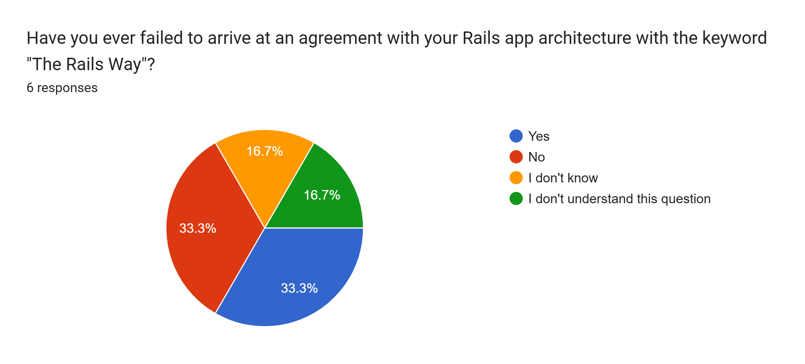
7. Survey and Answers

Slide 37
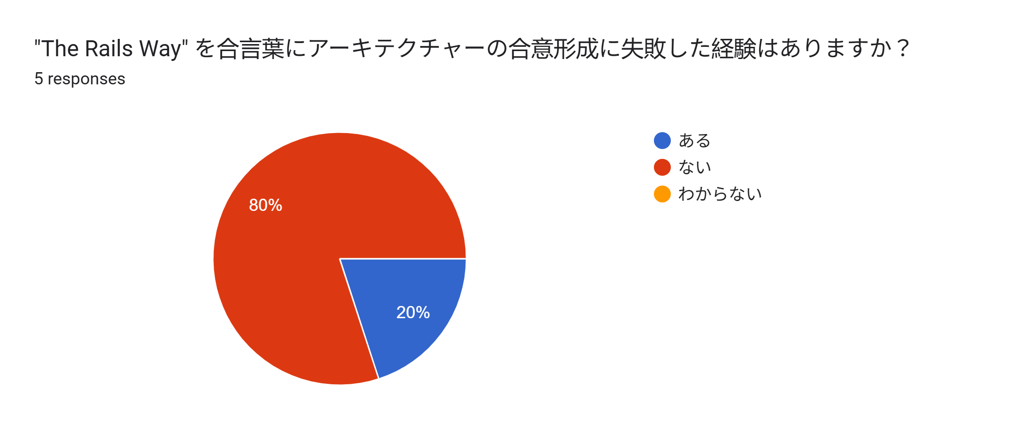
7. Survey and Answers

Slide 38
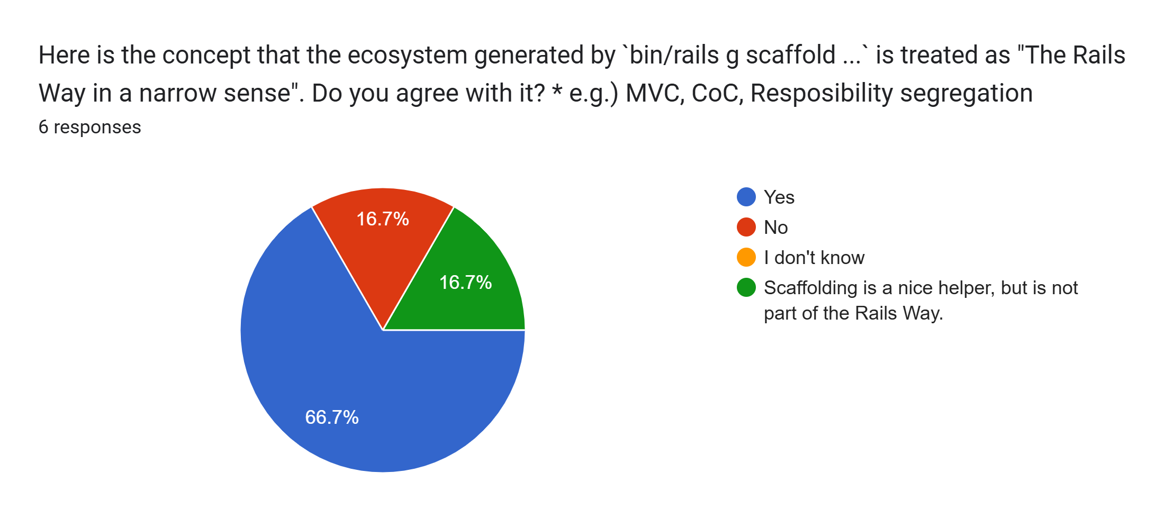
7. Survey and Answers

Slide 39
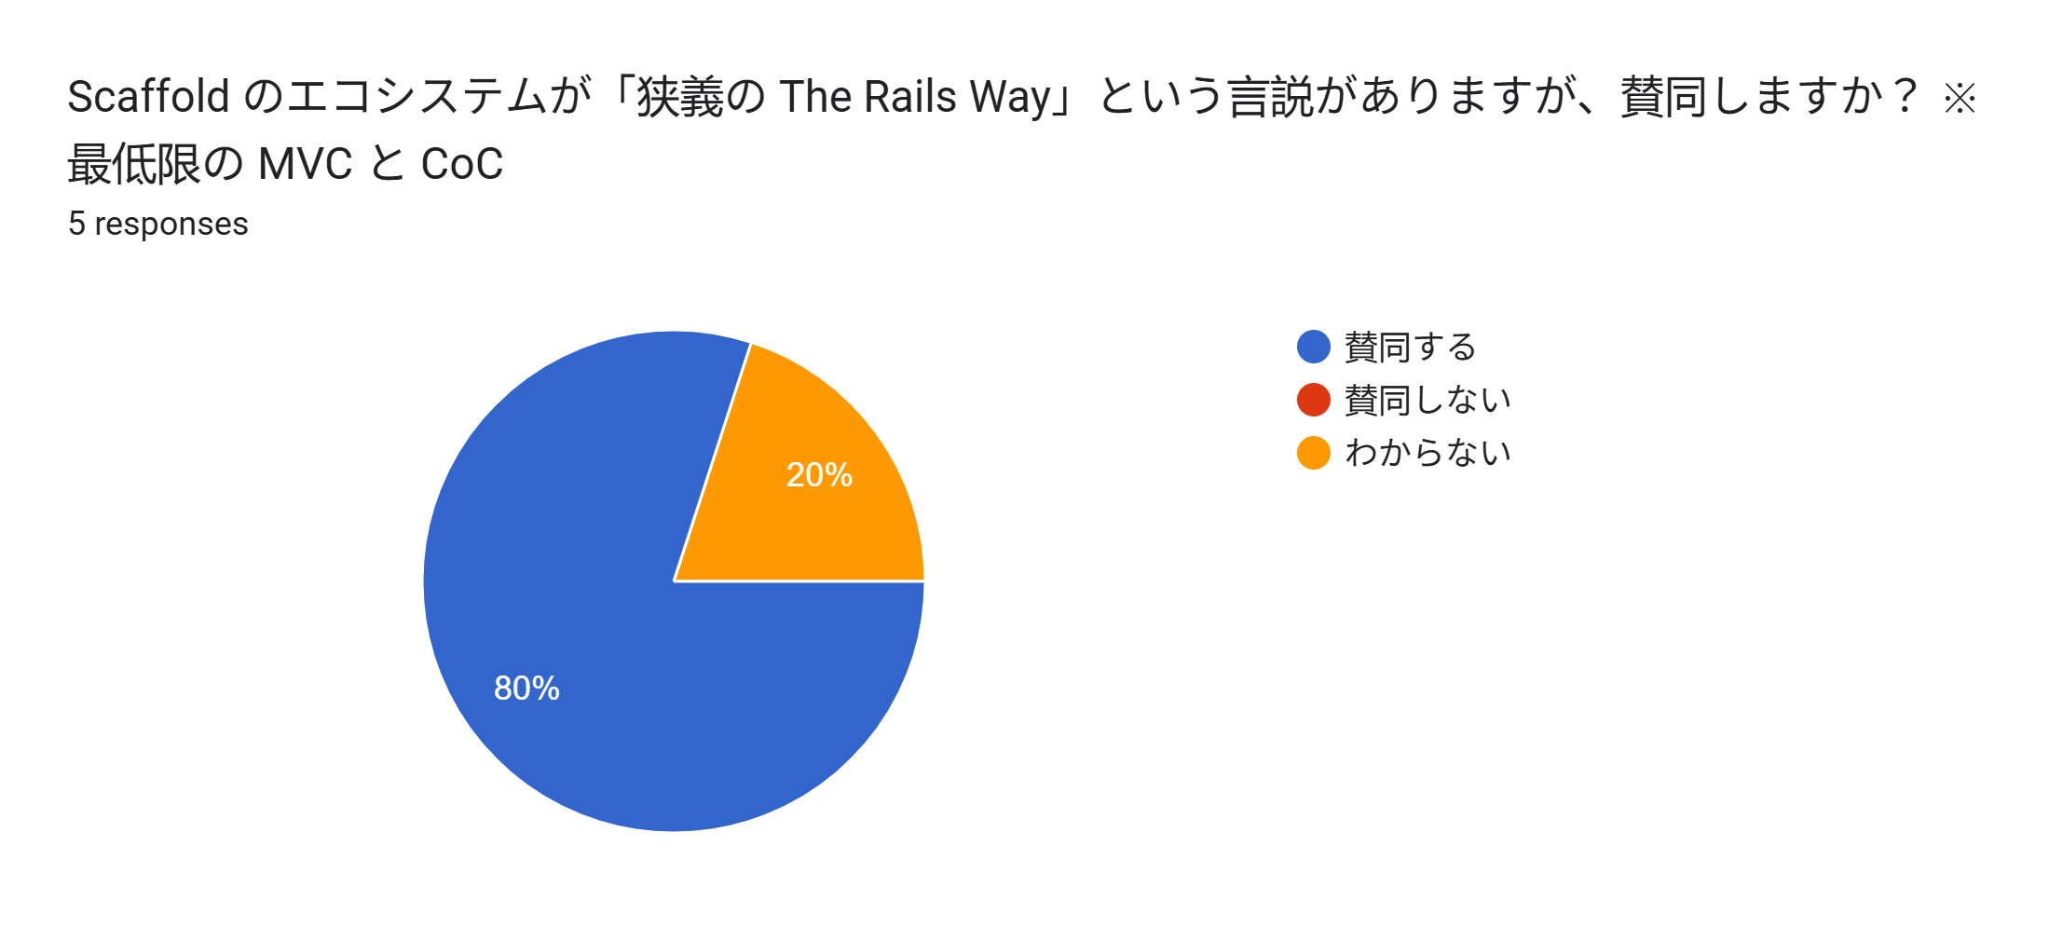
7. Survey and Answers

Slide 40
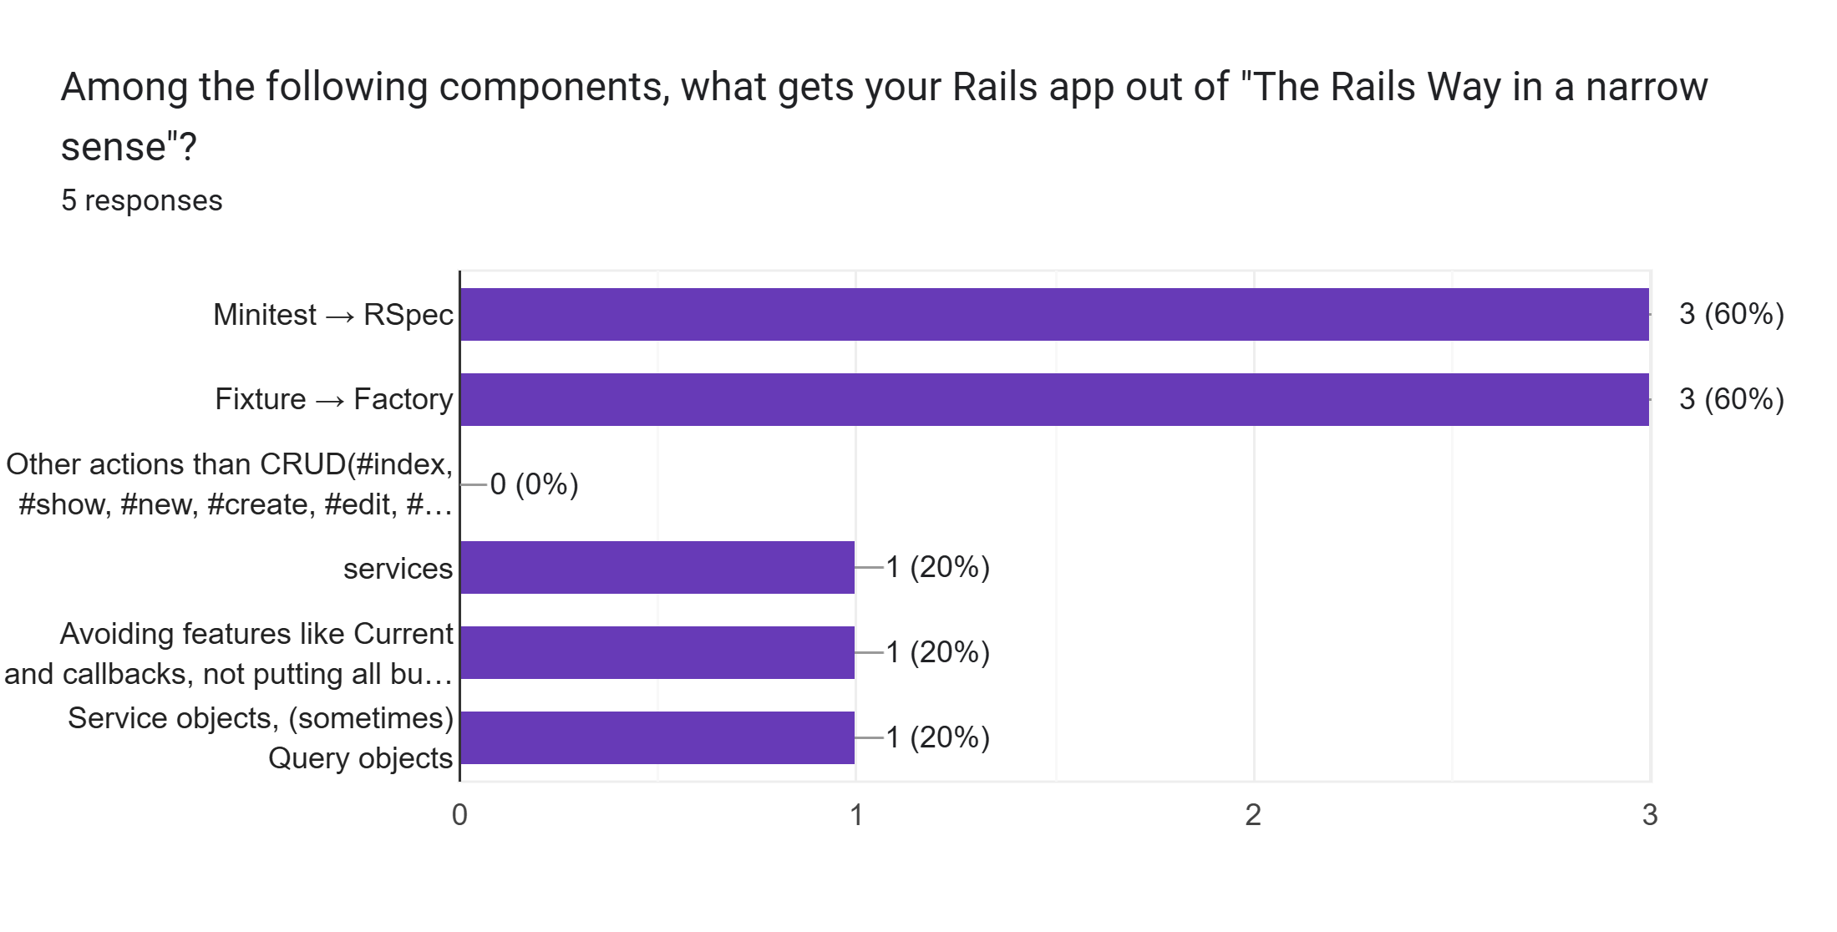
7. Survey and Answers

Slide 41
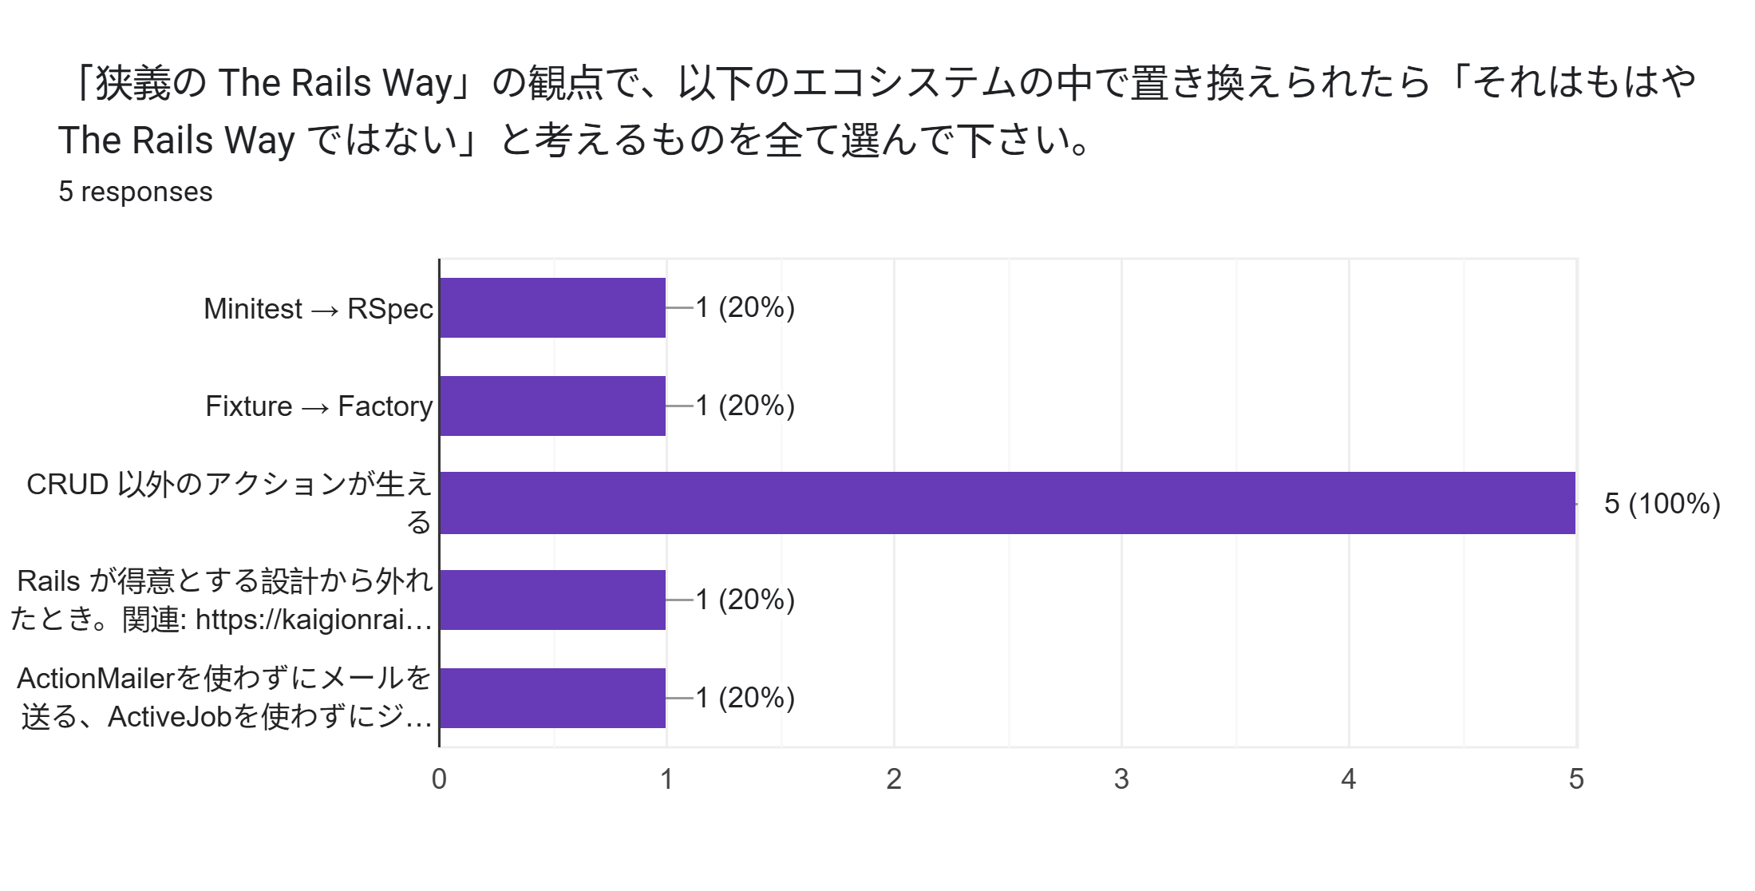
7. Survey and Answers

Slide 42
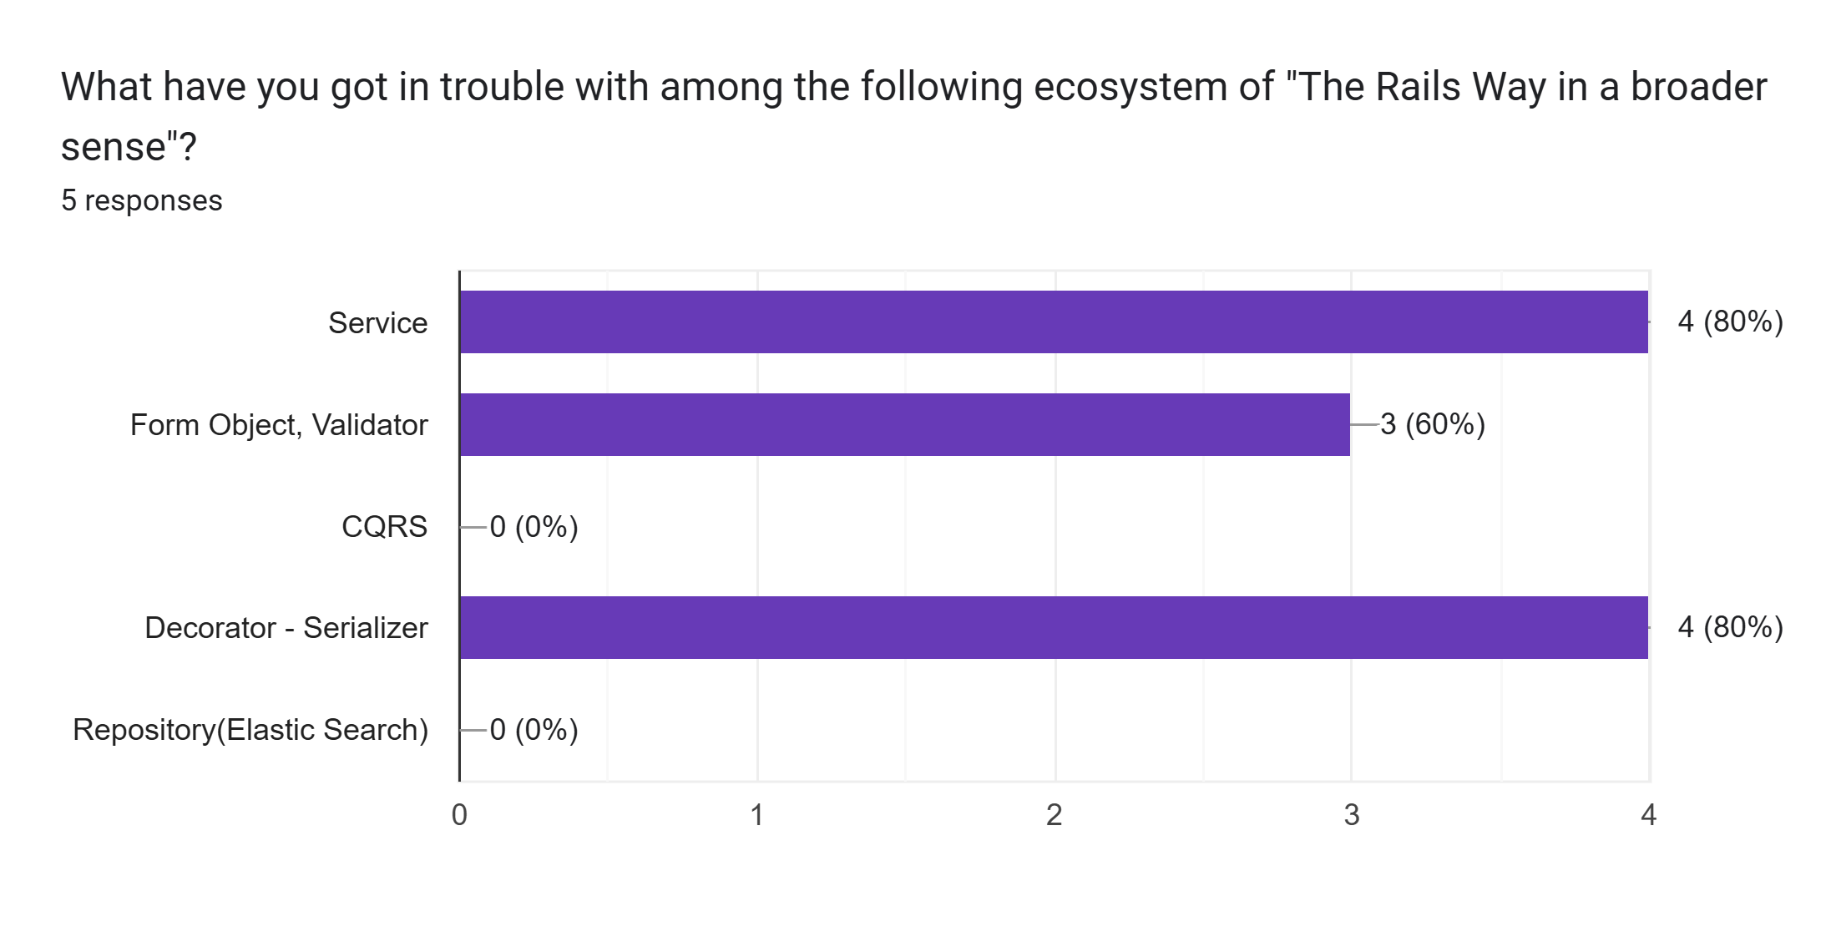
7. Survey and Answers

Slide 43
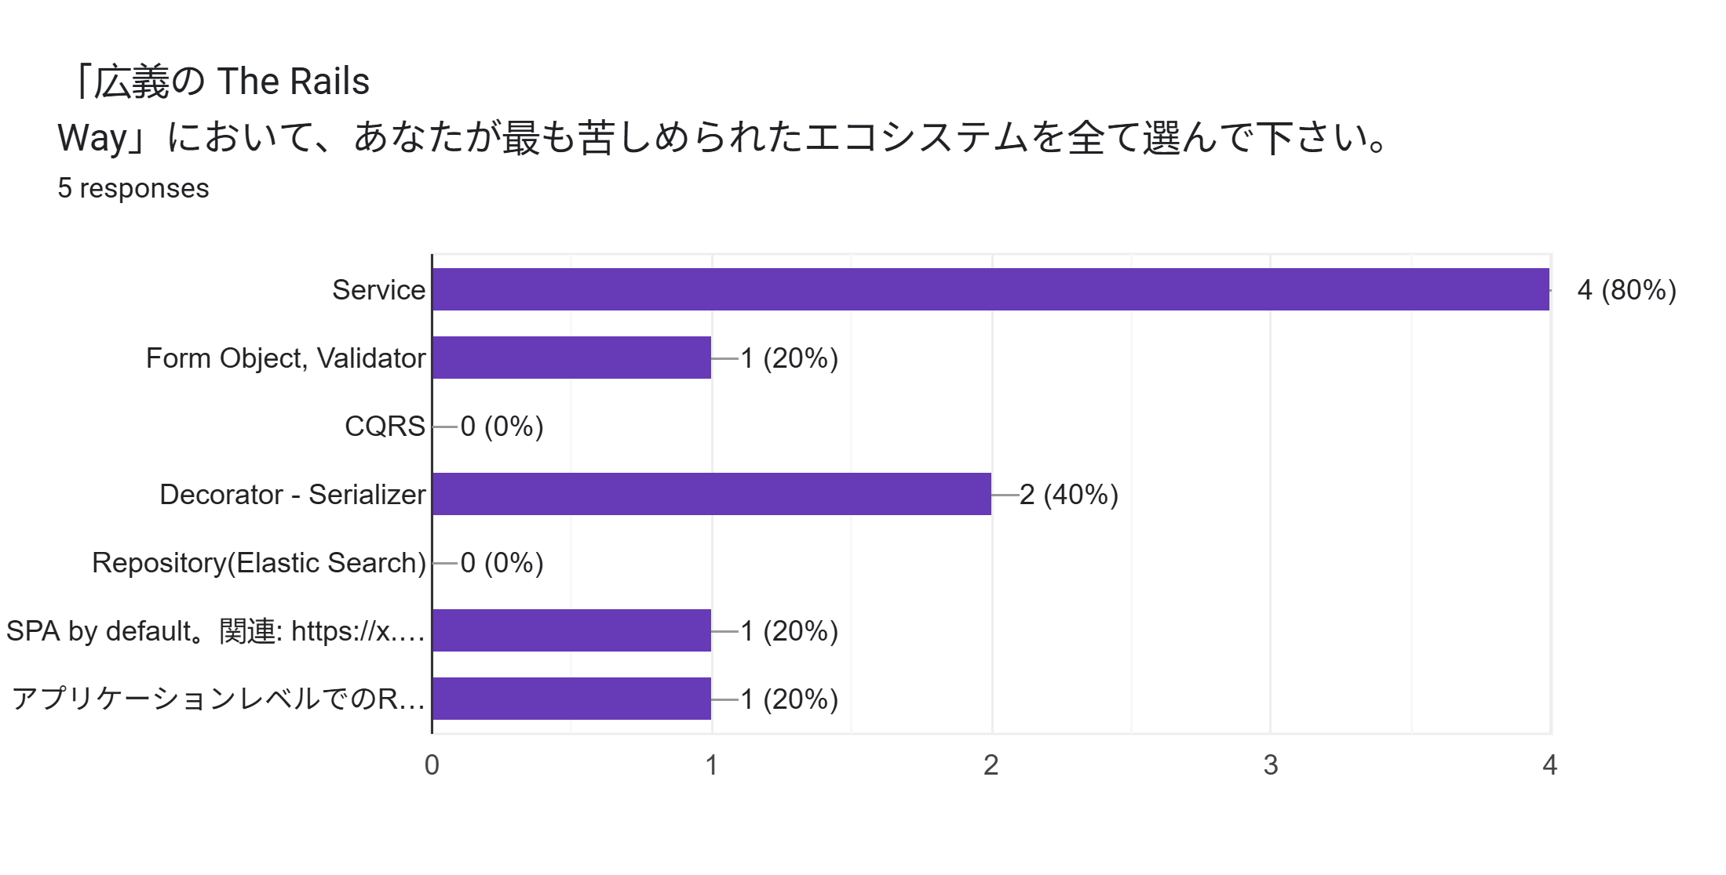
7. Survey and Answers
Rails-like arbitrary method implementations based on CoC at the application layer(including multiple uses of `method_missing`)

Slide 44
7. Survey and Answers
Q. Please feel free to describe the requirements which get your Rails app on "The Rails Way"? - International Rubyists
Not packing everything under umbrella of "Services", not overusing dry-rb, accepting ActiveRecord and business logic can be coupled
Following Rails' best practices, sticking to community favourites. Though personally I prefer to diverge from the Rails Way in multiple parts, I stick closer to it, when working with a growing team.
Rails is like Lego, they give you the bricks, and you build your own spaceship.
Sometime the decision on Rails are less optimized because it has to be abstracted.

Slide 45
7. Survey and Answers
Q. Please feel free to describe the requirements which get your Rails app on "The Rails Way"? - Japanese Rubyists(Partly extracted and processed)
As long as everybody recognize what the architecture is, the Rails application is on "The Rails Way"
rails new + scaffold => "The Rails Way"
CoC + RESTful resource design + Concentrate business logics on Model layer => "The Rails Way"
The practical ecosystem for the value maximization of delivery of the product is "The Rails Way" because no value means no survival for startups

Slide 46
8. Summary

Slide 47
8. Summary
Traditional MVC: Short path from idea to implementation, perfect for MVPs
→ "The Rails Way" in a narrower sense
Layered Approach: Clear boundaries, testable, maintainable at scale
→ "The Rails Way" in a broader sense
Pragmatic Migration: Start simple, add structure when complexity demands it.
Long-term Maintenance: Keep refactoring guided by real pain points
Narrower "The Rails Way": Most answers agreed with CoC + MVC
Broader "The Rails Way": Most answers were unhappy with Service Objects
Out of "The Rails Way": The case of replacement of default ecosystem among international Rubyists, in contrast to that of definition of other actions than CRUD among Japanese Rubyists

Slide 48
8. Summary
To cut a long story short…
"Think Less, Create More!" is The Rails Way!

Slide 49
9. References

Slide 50
9. References
Vladimir Dementyev, Layered Design for Ruby on Rails Application, Birmingham, 2023
Hayato Ishida, Layered Design for Ruby on Rails Application - Full Summary, Tokyo, 2025
Hayato Ishida, Layered Design for Ruby on Rails Application - Concise Summary, Tokyo, 2025
"The Rails Way" Survey - EN
"The Rails Way" Survey - JP
Statistics of "The Rails Way" Survey
dry-rb Gems
Last Accessed At: 12 November 2025

Slide 51
EOD

